Slide 1
Bid Summary - RFQ “FQ SIEM Tool”
August 2018

Slide 2
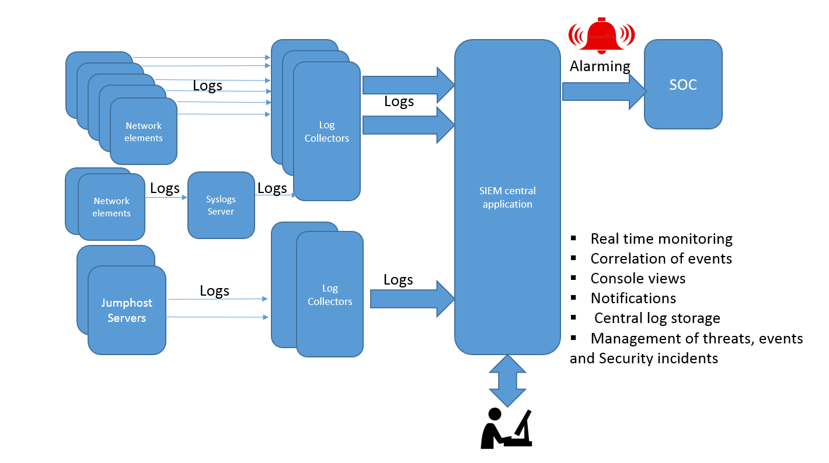
Background & Scope…
Telefónica Looking for a possible supplier for the implementation of a SIEM tool in order to comply with security requirements and increase security and protection of the network that is under the responsibility of the Network department.
Telefónica expects from the Vendor a modular approach (like a building box). This approach shall also be considered in the pricing model.
In case the offered Software product already has an installed base at Telefónica, this base shall be considered both technically and commercially in order to obtain the best results for Telefónica.
Reasons for Implementation
All the previous network audits or network elements audits required that the local logs shall be saved in a centralized manner and further analysed. Furthermore, a complex network as the one from Telefonica Germany needs a SIEM tool for, e. g.:
Detect and alert for unauthorized scanning and attacks (e.g. brute force attacks, DDoS attacks) on different network elements (e.g. FW, Router, DNS, HLR, Jumphost server)
Detect abnormal file transfers (depending on: file type, size, time of transfer, source IP, destination IP, username)
Detect abnormalities in different protocols and user behaviour
Detect Threats & Investigation possibilities (even for a longer period in the past) in a central platform for all network elements (e.g. DDoS attacks)
Receive regularly updates from others attack types worldwide
Rules & dashboards for detections of security leaks and attacks by combining different sources
Sending security relevant alarms into a central alarming tool and into a ticketing tool
Malware detection and identification of systems that have been compromised

Slide 3
Scope…
SIEM System Administration And Operation
SIEM System Monitoring
Daily System Health Check Report
End2end Measurements for SIEM System Performance
Housekeeping and Archiving
Upgrades and Updates
Virtualization
Platform and Application Monitoring
SIEM System Log Management
Backup and Restore
SIEM User Management & Authorization Concept
User Management & Authorization concept
Functional Requirements
Log Correlation & Use Cases
Generate alarms
Correlation rules standard
Correlation rules customized
GUI/Dashboard
User Interface
Archiving
Encryption
Scalability Log Collection
Scalability Log Processing
Log Collectors
Log Forwarding
OOTB Reporting
Integration External Systems (Malware information …)
License Exceeded
Filtering- User Query (Similar to correlation rules)
User Monitoring

Slide 4
Scope…
Basic Services
Technical Assistance Centre
Telephone Support
Remote Interrogation of Equipment
Third Line Support
Defect Prioritisation & Service Levels
Provision of Patches and Temporary Solutions
First Node Implementation of patches / temporary Solutions
Provision of Software Updates
First Node Implementation of Updates
Root Cause Analysis
Management Reporting
On Line / Web Based Reference Services
Optional Services
Field Force Dispatch
First Line Maintenance (FLM) - Engineer to Site
Second Line Support - Vendor (Remote)
L3 Engineer to Site
Remote Technical Support (Test Laboratory)
Roll Out of Patches/temporary Solutions
Roll Out of Updates
General Proactive Support
Provision of Software Upgrades (Operating Software)
First Node Implementation of Software Upgrades (Operating Software)
Roll Out of Software Upgrades (Operating Software)
Provision of Software Upgrades (Application Software)
First Node Implementation of Software Upgrades (Application Software)
Roll Out of Software Upgrades (Application Software)
On Site Technical Support (Test Laboratory)
N+24 Months
Service Delivery Note
Managed Spare Part Service
CWxxxx GCP Services and Works SIEM Annex 04 (Maintenance and Operations).docx

Slide 5
Key Points
Appendix 01 Process Overview - Third Line Support
Appendix 02 Defect Categorisation
Appendix 03 Service Levels
Appendix 04 Compensation For Failure To Meet Service Levels
Vendor shall be liable to pay the Purchaser Penalties (Service Credits) as a credit note as described below:
Appendix 05 Contacts
Basic Services – Third Line Support - REASONABLE ENDEAVOURS (R.E.) – BRONZE – SILVER – GOLD ( Critical / Major /Minor )
Optional Services
Recovery (Workaround) (Fix Problem or provide corrective measure) 600 EUR / hr Priority Critical AND400 EUR / hr Priority Major
Trouble Ticket Follow up, review and closure
Response, Recovery and Resolution times
Temporary Solution or Workaround
Software Updates and Software Upgrades
Trouble Ticket Status
amount of all reported closed Trouble Tickets
severity of a closed Trouble Ticket
open and closed time
SLA time (FLM / SLM / TLM)
Resolution 400 EUR / CD Priority Critical AND200 EUR / CD Priority Major
Severity Level - Critical / Major /Minor
FLM - Engineer to Site (according to Clause 3.2) Engineer to perform on Site corrective action - e.g. Defective board replacement
Medium - Response 30 mins / Recovery - 10 hrs.
Low - Response 1 hr. / Recovery - NBD
REASONABLE ENDEAVOURS - Response / Recovery - R.E.
High - Response 15 mins / Recovery - 4 hrs.
Appendix 06 Escalation Levels
Appendix 07 Ordered Services
To Be Filled
To Be Filled
To Be Filled
CWxxxx GCP Services and Works SIEM Annex 04 (Maintenance and Operations).docx

Slide 6
List of documents as a part of RFQ
Sr. # | Name | Item Type | SharePoint Path | Comment
1 | RFP Docs | Folder | bu/WLIB2/WLRepository/Telefonica_RFQ_SIEM_Tool | Folder
2 | 0_DUPLICATED_Compliance Matrix Templates BCM, Unica, etc | Folder | bu/WLIB2/WLRepository/Telefonica_RFQ_SIEM_Tool/RFP Docs | Folder
3 | 3_DUPLICATED_CWxxxx GCP Services and Works SIEM incl. Annexes | Folder | bu/WLIB2/WLRepository/Telefonica_RFQ_SIEM_Tool/RFP Docs | Folder
4 | 4_DUPLICATED_Compliance Matrix Templates BCM, Unica, etc | Folder | bu/WLIB2/WLRepository/Telefonica_RFQ_SIEM_Tool/RFP Docs | Folder
5 | ATTACHMENT 7 - Unica Documents | Folder | bu/WLIB2/WLRepository/Telefonica_RFQ_SIEM_Tool/RFP Docs | Folder
6 | Compliance Matrix Templates BCM, Unica, etc | Folder | bu/WLIB2/WLRepository/Telefonica_RFQ_SIEM_Tool/RFP Docs | Folder
7 | CWxxxx GCP Services and Works SIEM incl. Annexes | Folder | bu/WLIB2/WLRepository/Telefonica_RFQ_SIEM_Tool/RFP Docs | Folder
8 | PDFs | Folder | bu/WLIB2/WLRepository/Telefonica_RFQ_SIEM_Tool/RFP Docs | Folder
9 | Response Excels | Folder | bu/WLIB2/WLRepository/Telefonica_RFQ_SIEM_Tool/RFP Docs | Folder
10 | RFQ SIEM Tool_General Instructions (English Version) 2018.docx | Item | bu/WLIB2/WLRepository/Telefonica_RFQ_SIEM_Tool/RFP Docs | Instructions Docs (English Version)
11 | SIEM RFQ (Attachment 6) Functional-Requirements_FINAL.docx | Item | bu/WLIB2/WLRepository/Telefonica_RFQ_SIEM_Tool/RFP Docs | Functional-Requirements
12 | CWxxxx GCP Services and Works SIEM Annex 06 (Information Security) Vendor_Response_Template.xlsx | Item | bu/WLIB2/WLRepository/Telefonica_RFQ_SIEM_Tool/RFP Docs/0_DUPLICATED_Compliance Matrix Templates BCM, Unica, etc | Response Excel
13 | CWxxxx GCP Services and Works SIEM Annex 10 (BCM Requirements and Deliverables).xlsm | Item | bu/WLIB2/WLRepository/Telefonica_RFQ_SIEM_Tool/RFP Docs/0_DUPLICATED_Compliance Matrix Templates BCM, Unica, etc | Response Excel

Slide 7
List of documents as a part of RFQ
Sr. # | Name | Item Type | SharePoint Path | Comment
14 | CWxxxx GCP Services and Works SIEM Compliance Statement Annex 5,6, 8,9, 13a,13b.xlsx | Item | bu/WLIB2/WLRepository/Telefonica_RFQ_SIEM_Tool/RFP Docs/0_DUPLICATED_Compliance Matrix Templates BCM, Unica, etc | Response Excel
15 | SIEM RFQ Attachment 5 Compliance Matrix UNICA.xlsx | Item | bu/WLIB2/WLRepository/Telefonica_RFQ_SIEM_Tool/RFP Docs/0_DUPLICATED_Compliance Matrix Templates BCM, Unica, etc | Response Excel
16 | CWxxxx GCP Services and Works SIEM 2018 v1.1.docx | Item | bu/WLIB2/WLRepository/Telefonica_RFQ_SIEM_Tool/RFP Docs/3_DUPLICATED_CWxxxx GCP Services and Works SIEM incl. Annexes | Reference Doc
17 | CWxxxx GCP Services and Works SIEM Annex 00 (Milestone Plan).docx | Item | bu/WLIB2/WLRepository/Telefonica_RFQ_SIEM_Tool/RFP Docs/3_DUPLICATED_CWxxxx GCP Services and Works SIEM incl. Annexes | Reference Doc
18 | CWxxxx GCP Services and Works SIEM Annex 01 (Definitions) .docx | Item | bu/WLIB2/WLRepository/Telefonica_RFQ_SIEM_Tool/RFP Docs/3_DUPLICATED_CWxxxx GCP Services and Works SIEM incl. Annexes | Reference Doc
19 | CWxxxx GCP Services and Works SIEM Annex 02 (Specifications_Service Requirements).docx | Item | bu/WLIB2/WLRepository/Telefonica_RFQ_SIEM_Tool/RFP Docs/3_DUPLICATED_CWxxxx GCP Services and Works SIEM incl. Annexes | Reference Doc
20 | CWxxxx GCP Services and Works SIEM Annex 03 (Price Book).xlsx | Item | bu/WLIB2/WLRepository/Telefonica_RFQ_SIEM_Tool/RFP Docs/3_DUPLICATED_CWxxxx GCP Services and Works SIEM incl. Annexes | Pricing Sheet
21 | CWxxxx GCP Services and Works SIEM Annex 04 (Maintenance and Operations).docx | Item | bu/WLIB2/WLRepository/Telefonica_RFQ_SIEM_Tool/RFP Docs/3_DUPLICATED_CWxxxx GCP Services and Works SIEM incl. Annexes | Reference Doc

Slide 8
List of documents as a part of RFQ
Sr. # | Name | Item Type | SharePoint Path | Comment
22 | CWxxxx GCP Services and Works SIEM Annex 05 (Quality Assurance).docx | Item | bu/WLIB2/WLRepository/Telefonica_RFQ_SIEM_Tool/RFP Docs/3_DUPLICATED_CWxxxx GCP Services and Works SIEM incl. Annexes | Reference Doc
23 | CWxxxx GCP Services and Works SIEM Annex 06 (Information Security).pdf | Item | bu/WLIB2/WLRepository/Telefonica_RFQ_SIEM_Tool/RFP Docs/3_DUPLICATED_CWxxxx GCP Services and Works SIEM incl. Annexes | Reference Doc
24 | CWxxxx GCP Services and Works SIEM Annex 07 (Acceptance Procedure).docx | Item | bu/WLIB2/WLRepository/Telefonica_RFQ_SIEM_Tool/RFP Docs/3_DUPLICATED_CWxxxx GCP Services and Works SIEM incl. Annexes | Acceptance Procedure
25 | CWxxxx GCP Services and Works SIEM Annex 08 (Documentation).pdf | Item | bu/WLIB2/WLRepository/Telefonica_RFQ_SIEM_Tool/RFP Docs/3_DUPLICATED_CWxxxx GCP Services and Works SIEM incl. Annexes | Reference Doc
26 | CWxxxx GCP Services and Works SIEM Annex 09 (Supply Chain Sustainability Policy).pdf | Item | bu/WLIB2/WLRepository/Telefonica_RFQ_SIEM_Tool/RFP Docs/3_DUPLICATED_CWxxxx GCP Services and Works SIEM incl. Annexes | Reference Doc
27 | CWxxxx GCP Services and Works SIEM Annex 10 (Business Continuity Management).docx | Item | bu/WLIB2/WLRepository/Telefonica_RFQ_SIEM_Tool/RFP Docs/3_DUPLICATED_CWxxxx GCP Services and Works SIEM incl. Annexes | Reference Doc
28 | CWxxxx GCP Services and Works SIEM Annex 11 (Commissioned Data Processing).docx | Item | bu/WLIB2/WLRepository/Telefonica_RFQ_SIEM_Tool/RFP Docs/3_DUPLICATED_CWxxxx GCP Services and Works SIEM incl. Annexes | Reference Doc
29 | CWxxxx GCP Services and Works SIEM Annex 12 (EU Model Clauses).docx | Item | bu/WLIB2/WLRepository/Telefonica_RFQ_SIEM_Tool/RFP Docs/3_DUPLICATED_CWxxxx GCP Services and Works SIEM incl. Annexes | Reference Doc

Slide 9
List of documents as a part of RFQ
Sr. # | Name | Item Type | SharePoint Path | Comment
30 | CWxxxx GCP Services and Works SIEM Annex 13a (Health and Safety).docx | Item | bu/WLIB2/WLRepository/Telefonica_RFQ_SIEM_Tool/RFP Docs/3_DUPLICATED_CWxxxx GCP Services and Works SIEM incl. Annexes | Reference Doc
31 | CWxxxx GCP Services and Works SIEM Annex 13b (Environmental Management).docx | Item | bu/WLIB2/WLRepository/Telefonica_RFQ_SIEM_Tool/RFP Docs/3_DUPLICATED_CWxxxx GCP Services and Works SIEM incl. Annexes | Reference Doc
32 | CWxxxx GCP Services and Works SIEM Annex 06 (Information Security) Vendor_Response_Template.xlsx | Item | bu/WLIB2/WLRepository/Telefonica_RFQ_SIEM_Tool/RFP Docs/4_DUPLICATED_Compliance Matrix Templates BCM, Unica, etc | Response Excel
33 | CWxxxx GCP Services and Works SIEM Annex 10 (BCM Requirements and Deliverables).xlsm | Item | bu/WLIB2/WLRepository/Telefonica_RFQ_SIEM_Tool/RFP Docs/4_DUPLICATED_Compliance Matrix Templates BCM, Unica, etc | Response Excel
34 | CWxxxx GCP Services and Works SIEM Compliance Statement Annex 5,6, 8,9, 13a,13b.xlsx | Item | bu/WLIB2/WLRepository/Telefonica_RFQ_SIEM_Tool/RFP Docs/4_DUPLICATED_Compliance Matrix Templates BCM, Unica, etc | Response Excel
35 | SIEM RFQ Attachment 5 Compliance Matrix UNICA.xlsx | Item | bu/WLIB2/WLRepository/Telefonica_RFQ_SIEM_Tool/RFP Docs/4_DUPLICATED_Compliance Matrix Templates BCM, Unica, etc | Response Excel
36 | Attachment 7_UNICA - Additional Documentation.7z.txt | Item | bu/WLIB2/WLRepository/Telefonica_RFQ_SIEM_Tool/RFP Docs/ATTACHMENT 7 - Unica Documents | Reference Doc
37 | e2e_vapp_ovf.ovf | Item | bu/WLIB2/WLRepository/Telefonica_RFQ_SIEM_Tool/RFP Docs/ATTACHMENT 7 - Unica Documents | Reference Doc
38 | E2EvAPP_HOT.yaml | Item | bu/WLIB2/WLRepository/Telefonica_RFQ_SIEM_Tool/RFP Docs/ATTACHMENT 7 - Unica Documents | Reference Doc
39 | UNICA Infra R2.1 - VNF Descriptors-20180522.pdf | Item | bu/WLIB2/WLRepository/Telefonica_RFQ_SIEM_Tool/RFP Docs/ATTACHMENT 7 - Unica Documents | Reference Doc

Slide 10
List of documents as a part of RFQ
Sr. # | Name | Item Type | SharePoint Path | Comment
40 | UNICA Infra R2.1 - VNF LC Management Description Model 1-20180205.pdf | Item | bu/WLIB2/WLRepository/Telefonica_RFQ_SIEM_Tool/RFP Docs/ATTACHMENT 7 - Unica Documents | Reference Doc
41 | CWxxxx GCP Services and Works SIEM Annex 06 (Information Security) Vendor_Response_Template.xlsx | Item | bu/WLIB2/WLRepository/Telefonica_RFQ_SIEM_Tool/RFP Docs/Compliance Matrix Templates BCM, Unica, etc | Response Excel
42 | CWxxxx GCP Services and Works SIEM Annex 10 (BCM Requirements and Deliverables).xlsm | Item | bu/WLIB2/WLRepository/Telefonica_RFQ_SIEM_Tool/RFP Docs/Compliance Matrix Templates BCM, Unica, etc | Response Excel
43 | CWxxxx GCP Services and Works SIEM Compliance Statement Annex 5,6, 8,9, 13a,13b.xlsx | Item | bu/WLIB2/WLRepository/Telefonica_RFQ_SIEM_Tool/RFP Docs/Compliance Matrix Templates BCM, Unica, etc | Response Excel
44 | SIEM RFQ Attachment 5 Compliance Matrix UNICA.xlsx | Item | bu/WLIB2/WLRepository/Telefonica_RFQ_SIEM_Tool/RFP Docs/Compliance Matrix Templates BCM, Unica, etc | Response Excel
45 | CWxxxx GCP Services and Works SIEM 2018 v1.1.docx | Item | bu/WLIB2/WLRepository/Telefonica_RFQ_SIEM_Tool/RFP Docs/CWxxxx GCP Services and Works SIEM incl. Annexes | Reference Doc
46 | CWxxxx GCP Services and Works SIEM Annex 00 (Milestone Plan).docx | Item | bu/WLIB2/WLRepository/Telefonica_RFQ_SIEM_Tool/RFP Docs/CWxxxx GCP Services and Works SIEM incl. Annexes | Reference Doc
47 | CWxxxx GCP Services and Works SIEM Annex 01 (Definitions) .docx | Item | bu/WLIB2/WLRepository/Telefonica_RFQ_SIEM_Tool/RFP Docs/CWxxxx GCP Services and Works SIEM incl. Annexes | Reference Doc
48 | CWxxxx GCP Services and Works SIEM Annex 02 (Specifications_Service Requirements).docx | Item | bu/WLIB2/WLRepository/Telefonica_RFQ_SIEM_Tool/RFP Docs/CWxxxx GCP Services and Works SIEM incl. Annexes | Reference Doc
49 | CWxxxx GCP Services and Works SIEM Annex 03 (Price Book).xlsx | Item | bu/WLIB2/WLRepository/Telefonica_RFQ_SIEM_Tool/RFP Docs/CWxxxx GCP Services and Works SIEM incl. Annexes | Pricing Sheet
50 | CWxxxx GCP Services and Works SIEM Annex 04 (Maintenance and Operations).docx | Item | bu/WLIB2/WLRepository/Telefonica_RFQ_SIEM_Tool/RFP Docs/CWxxxx GCP Services and Works SIEM incl. Annexes | Reference Doc

Slide 11
List of documents as a part of RFQ
Sr. # | Name | Item Type | SharePoint Path | Comment
51 | CWxxxx GCP Services and Works SIEM Annex 05 (Quality Assurance).docx | Item | bu/WLIB2/WLRepository/Telefonica_RFQ_SIEM_Tool/RFP Docs/CWxxxx GCP Services and Works SIEM incl. Annexes | Reference Doc
52 | CWxxxx GCP Services and Works SIEM Annex 06 (Information Security).pdf | Item | bu/WLIB2/WLRepository/Telefonica_RFQ_SIEM_Tool/RFP Docs/CWxxxx GCP Services and Works SIEM incl. Annexes | Reference Doc
53 | CWxxxx GCP Services and Works SIEM Annex 07 (Acceptance Procedure).docx | Item | bu/WLIB2/WLRepository/Telefonica_RFQ_SIEM_Tool/RFP Docs/CWxxxx GCP Services and Works SIEM incl. Annexes | Reference Doc
54 | CWxxxx GCP Services and Works SIEM Annex 08 (Documentation).pdf | Item | bu/WLIB2/WLRepository/Telefonica_RFQ_SIEM_Tool/RFP Docs/CWxxxx GCP Services and Works SIEM incl. Annexes | Reference Doc
55 | CWxxxx GCP Services and Works SIEM Annex 09 (Supply Chain Sustainability Policy).pdf | Item | bu/WLIB2/WLRepository/Telefonica_RFQ_SIEM_Tool/RFP Docs/CWxxxx GCP Services and Works SIEM incl. Annexes | Reference Doc
56 | CWxxxx GCP Services and Works SIEM Annex 10 (Business Continuity Management).docx | Item | bu/WLIB2/WLRepository/Telefonica_RFQ_SIEM_Tool/RFP Docs/CWxxxx GCP Services and Works SIEM incl. Annexes | Reference Doc
57 | CWxxxx GCP Services and Works SIEM Annex 11 (Commissioned Data Processing).docx | Item | bu/WLIB2/WLRepository/Telefonica_RFQ_SIEM_Tool/RFP Docs/CWxxxx GCP Services and Works SIEM incl. Annexes | Reference Doc
58 | CWxxxx GCP Services and Works SIEM Annex 12 (EU Model Clauses).docx | Item | bu/WLIB2/WLRepository/Telefonica_RFQ_SIEM_Tool/RFP Docs/CWxxxx GCP Services and Works SIEM incl. Annexes | Reference Doc
59 | CWxxxx GCP Services and Works SIEM Annex 13a (Health and Safety).docx | Item | bu/WLIB2/WLRepository/Telefonica_RFQ_SIEM_Tool/RFP Docs/CWxxxx GCP Services and Works SIEM incl. Annexes | Reference Doc
60 | CWxxxx GCP Services and Works SIEM Annex 13b (Environmental Management).docx | Item | bu/WLIB2/WLRepository/Telefonica_RFQ_SIEM_Tool/RFP Docs/CWxxxx GCP Services and Works SIEM incl. Annexes | Reference Doc
61 | Anticorruption Obligations Obligaciones Anticorrupción.pdf | Item | bu/WLIB2/WLRepository/Telefonica_RFQ_SIEM_Tool/RFP Docs/PDFs | Reference Doc

Slide 12
List of documents as a part of RFQ
Sr. # | Name | Item Type | SharePoint Path | Comment
62 | Confidenciality Notice - Aviso Confidencialidad.pdf | Item | bu/WLIB2/WLRepository/Telefonica_RFQ_SIEM_Tool/RFP Docs/PDFs | Reference Doc
63 | E-COMMERCE OPERATIONS.pdf | Item | bu/WLIB2/WLRepository/Telefonica_RFQ_SIEM_Tool/RFP Docs/PDFs | Reference Doc
64 | MCT NI 003 Condiciones Generales para el Suministro de Bienes Mayo 2018.pdf | Item | bu/WLIB2/WLRepository/Telefonica_RFQ_SIEM_Tool/RFP Docs/PDFs | Reference Doc
65 | MCT NI 004 Condiciones Generales para la Prestación de Servicios Mayo 2018.pdf | Item | bu/WLIB2/WLRepository/Telefonica_RFQ_SIEM_Tool/RFP Docs/PDFs | Reference Doc
66 | MCT.NI.003 General Conditions for the Supply of Goods May 2018_.pdf | Item | bu/WLIB2/WLRepository/Telefonica_RFQ_SIEM_Tool/RFP Docs/PDFs | Reference Doc
67 | MCT.NI.004 General Conditions for providing services May 2018.pdf | Item | bu/WLIB2/WLRepository/Telefonica_RFQ_SIEM_Tool/RFP Docs/PDFs | Reference Doc
68 | Policy of Sustainability in the Supply Chain_July 2016 (ENG).pdf | Item | bu/WLIB2/WLRepository/Telefonica_RFQ_SIEM_Tool/RFP Docs/PDFs | Reference Doc
69 | Política Sostenibilidad en la Cadena de Suministro_Julio 2016 (ESP).pdf | Item | bu/WLIB2/WLRepository/Telefonica_RFQ_SIEM_Tool/RFP Docs/PDFs | Reference Doc
70 | Telefonica Germany_Einkaufs_AGB_01-2018.pdf | Item | bu/WLIB2/WLRepository/Telefonica_RFQ_SIEM_Tool/RFP Docs/PDFs | Reference Doc
71 | Telefónica Germany_Purchasing_TC_01-2018.pdf | Item | bu/WLIB2/WLRepository/Telefonica_RFQ_SIEM_Tool/RFP Docs/PDFs | Reference Doc
72 | TGS - SSA 4 Percent - January 2017.pdf | Item | bu/WLIB2/WLRepository/Telefonica_RFQ_SIEM_Tool/RFP Docs/PDFs | Reference Doc

Slide 13
List of documents as a part of RFQ
Sr. # | Name | Item Type | SharePoint Path | Comment
73 | 1_DUPLICATED_CWxxxx GCP Services and Works SIEM Annex 03 (Price Book).xlsx | Item | bu/WLIB2/WLRepository/Telefonica_RFQ_SIEM_Tool/RFP Docs/Response Excels | Pricing Sheet
74 | 2_DUPLICATED_SIEM RFQ Attachment 1 Questions and Answers.xlsx | Item | bu/WLIB2/WLRepository/Telefonica_RFQ_SIEM_Tool/RFP Docs/Response Excels | Q&A Sheet
75 | Catalog_Template_VF_28.05.2018.xls | Item | bu/WLIB2/WLRepository/Telefonica_RFQ_SIEM_Tool/RFP Docs/Response Excels | Response Excel
76 | CWxxxx GCP Services and Works SIEM Annex 03 (Price Book).xlsx | Item | bu/WLIB2/WLRepository/Telefonica_RFQ_SIEM_Tool/RFP Docs/Response Excels | Response Excel
77 | SIEM RFQ (Attachment 2) Functional Requirements-Compliance-Matrix_FINAL.xlsx | Item | bu/WLIB2/WLRepository/Telefonica_RFQ_SIEM_Tool/RFP Docs/Response Excels | Response Excel
78 | SIEM RFQ (Attachment 2) Service Requirements-Compliance-Matrix_FINAL.xlsx | Item | bu/WLIB2/WLRepository/Telefonica_RFQ_SIEM_Tool/RFP Docs/Response Excels | Response Excel
79 | SIEM RFQ Attachment 1 Questions and Answers.xlsx | Item | bu/WLIB2/WLRepository/Telefonica_RFQ_SIEM_Tool/RFP Docs/Response Excels | Q&A Sheet

Slide 14
Bid Qualification Scorecard

Slide 15
Time Line
DATE | DESCRIPTION
August 16th, 2018 | RFQ launch via Telefónica’s e-procurement platform (Adquira)
August 20th, 2018 | Proposers confirms their interest via e-mail to bid for the RFQ
August 27th, 2018 | Proposer’s questions to be inserted into the provided question & answer template and submitted via e-mail to Telefónica’s Technical and Procurement contact person. Proposers shall submit its questions only in one batch.
September 3rd, 2018 | Telefónica to send the answer document to all participants via Adquira.
September 14th, 2018 | Proposers to upload the complete RFQ response via Adquira to Telefónica.
September 28th ,2018 | Analysis of responses and questions by CONTRACTOR
September October 8th to October 10th, 2018 | Supplier Presentations to take place
October 12th, 2018 | Communication regarding the shortlisting of Proposers.
October 15th, 2018 – October 26th, 2018 | Commercial Negotiation & Contractual Negotiations
November 2nd, 2018 | Final Supplier Selection
November 9th, 2018 | Contract Signature
* The dates may be altered at any time at the convenience of the CONTRACTOR.

Slide 16
Thank you

Slide 17
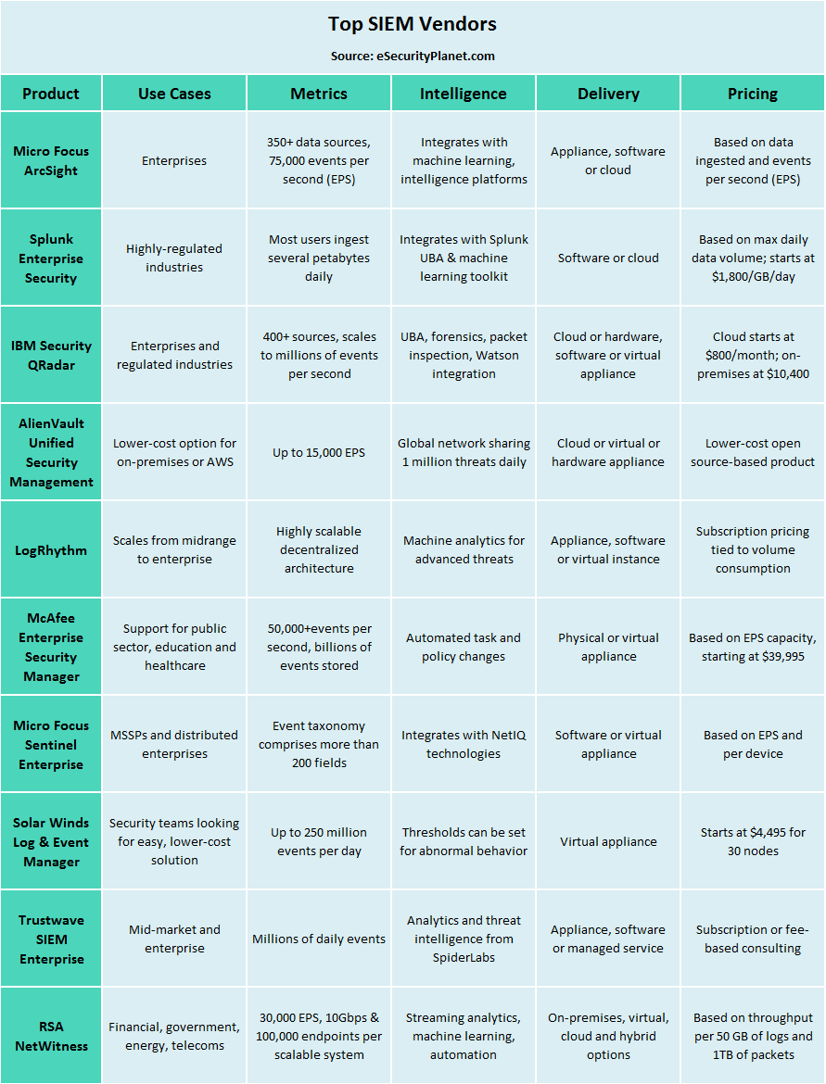
Top 10 SIEM Products

Slide 18
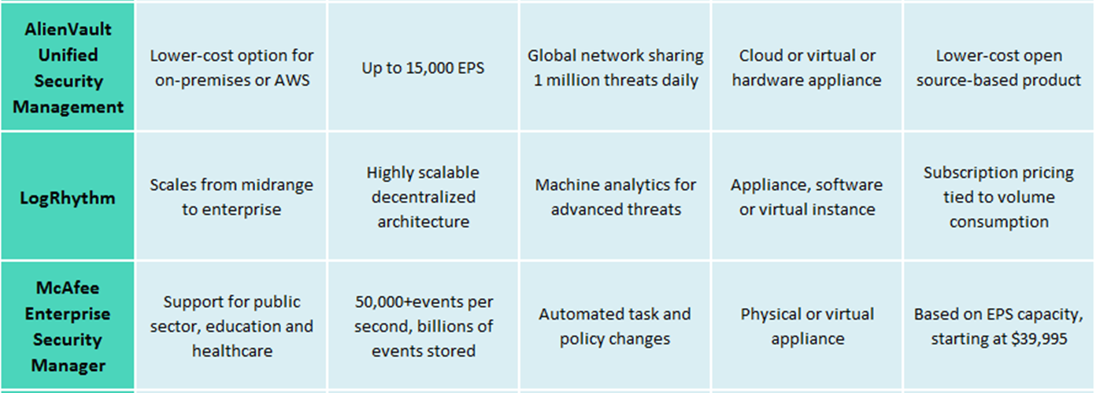
Top 10 SIEM Products

Slide 19
Top 10 SIEM Products

